Slide 1
ArticleRater: A strategy for dealing with fake news
BY: MICAH COOKE AND SEAN ALEMAN

Slide 2
Real Life Problem: Biased or so-called “Fake-News”
We live in ironic times: All the information at our fingertips, yet determining the objective truth is extremely difficult.
Media is rewarded for emotional and exaggerated stories, gossip makes money, and just like the saying goes, “If it bleeds, it leads.”
How do we determine what is true or what is false? Who should we believe?

Slide 3
Who do we believe?

Slide 4
Multi-layered and complicated problem.
Some scientists and philosophers think that there is no such thing as objective truth, just a combination of every possible way to view an event.
Take chocolate for example. We can only study it via senses and tools currently created. Maybe in the future there will be a better tool that can detect the chocolate in a way not currently known. Since we don’t know all the ways in which one can observe an item or an event, there is no such thing as real objective truth.
This leads to what’s called post-modernism in philosophy.

Slide 5
Complications part 2:
Post modernism says that there are a lot of different ways to validly look at anything.
Therefore, many varied views can be valid about a particular subject.
In our earlier example, it turns out that both views are correct. The guy claimed he presumed there was quid pro quo, but he also claimed that he never heard directly about there being quid pro quo.
See, determining the truth is complicated.

Slide 6
Hypothesis
Because emotional language can be a tool used to manipulate, we think that articles that contain more emotionally charged words are more biased than articles that contain less emotionally charged words.

Slide 7
Our idea
Use a computer algorithm to read through media sources, whether it is audio, video, or text format, and determine a rating of how biased the article is by counting the total amount of emotional words.
Because of the large data size of all the media, using parallel programming to do this task will be much more efficient.
This program is the initial step to this idea. The goal here is to read in any text file and use parallel programming to get the total word count. We are not comparing emotional words yet.

Slide 8
First Steps
Create an algorithm that can open a file and read through all the words.
Take that input file and store it in a global array, line by line.
Split up the array evenly so that each process handles the same amount of text lines for the best efficiency.
For example, if there are 800 lines that were transcribed from a news video, and we had 8 processes we could use, then each process would handle 100 lines.
Each process calculates the number of words in their given text lines
Process 0 handles any left over lines if the text lines don’t divide evenly

Slide 9
Problems
OMG DID WE HAVE PROBLEMS!
We tried to read in from a file and break it evenly into separate files, one file per process.
Tried various techniques but the following worked well: split -n 8 text.txt --additional-suffix=.txtc
Was used in script to split files.
Couldn’t open the split files and switched to read into an array

Slide 10
Problems part2:
We stopped trying to split it into files, and tried to read whole file in one process, and send partial arrays to other processes through the use of SCATTER.
When allocating 2D array in memory, it is not contiguous, so when using scatter, it doesn’t send the actual array, instead it takes a contiguous chunk from array[0].

Slide 11
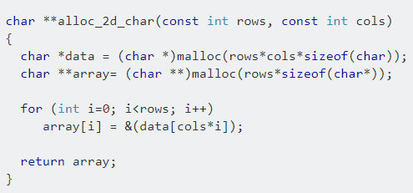
Problems Part 3
Tried to use Function to allocate correct size of contiguous 2d char array:
But...
Didn’t work...

Slide 12
Serial Description
Open file
Use “timer.h” for timing
Set a flag variable to 0
Get each character with getc
Use while loop to get characters until end of the file
If statement: if the character is an alphabetical letter, a digit, or a punctuation mark, then set the flag to 1
If statement: if the character is a space and the flag is 1, then add to total word count and reset flag to 0
After while loop, If statement: if flag is 1, then add to word count again because the file ended on another word

Slide 13
Parallel Version 1 Description
Open file
Use MPI_Wtime for timing
Get each line of text and make it an element of 2D array
Divide number of lines by number of processes for “size” variable
Process 0 takes any left over lines plus “size” number of lines
Process 0 sends a portion of 2D array to other processes
Each process counts the words for their “size” number of lines
Each process has a local variable for their word count
Each local variable is stored in Sum array
Process 0 adds the elements of the Sum array to get the total word count

Slide 14
Solution Version 1

Slide 15
Parallel Version 2 Description
All processes open the file.
The processes begins to read file but skip lines until line i% processes == 0.
So: on line 9 , 9%8 = 1, so rank 1 will read in the line.
In this way, each process reads in alternating lines.
While reading in line each process calls to calculate word count.
Then MPI REDUCE is used to calculate total words.

Slide 16
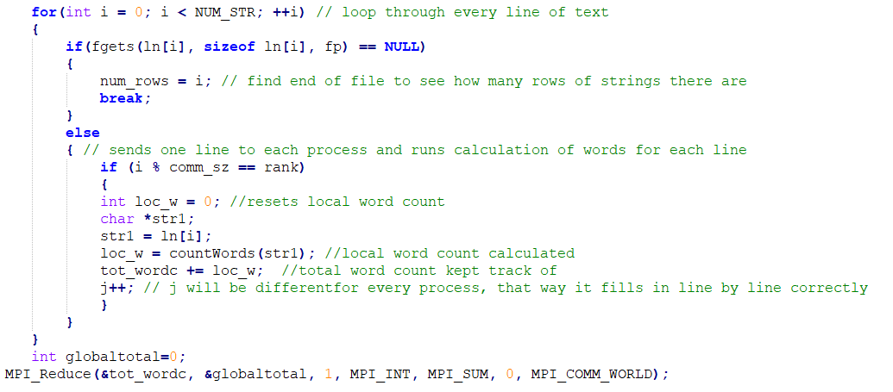
Solution Version 2

Slide 17
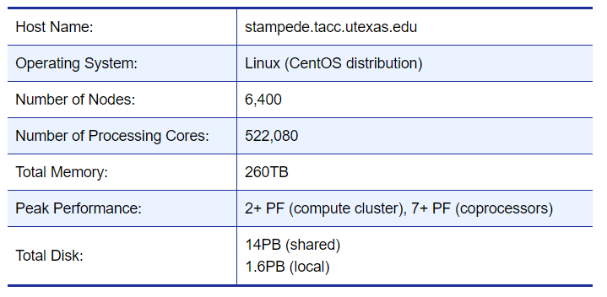
Stampede Hardware Specs
High performance computing and low power per operation
Highly programmable
High bandwidth and low latency
Thermal energy storage to reduce peak power consumption
Hot aisle containment to boost efficiency
Datacenter power increased to ~12MW

Slide 18
Software used for project:
Stampede
Excel
Google Slides
Notepad++
Putty
WinSCP

Slide 19
Project Requirement Answers:
Problem sizes: 1779, 17790 (number of words)
We chose these problem sizes because we just found a random file size, then we wanted a file 10x the size, so we just copied and pasted it 10x for the second file size.
Number of processes used: 1, 8, 16

Slide 20
Compilation and Execution Commands
Serial
Compile: mpicc AlemanCookeFPser.c -o mycode.exe
Run: sbatch serscript
Parallel Version 1
Compile: mpicc AlemanCookeFPv1.c -o mycode.exe
Run: sbatch parv1script
Parallel Version 2
Compile: mpicc AlemanCookeFPv2.c -o mycode.exe
Run: sbatch parv2script

Slide 21
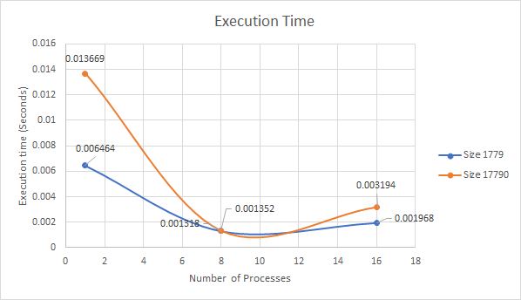
Execution Time for Version 1
Execution Times {seconds} for Parallel V1
 | Problem Size (N)
# Proc (comm_sz) | 1779 | 17790
1 | 0.006464 | 0.013669
8 | 0.001318 | 0.001352
16 | 0.001968 | 0.003194

Slide 22
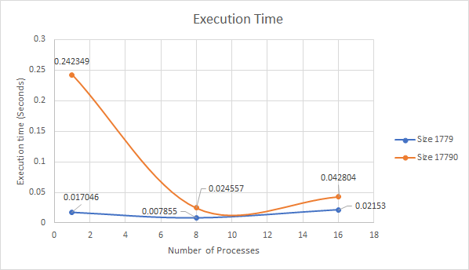
Execution Time for Version 2
Execution Times {seconds} for Parallel V2
 | Problem Size (N)
# Proc (comm_sz) | 1779 | 17790
1 | 0.017046 | 0.242349
8 | 0.007855 | 0.024557
16 | 0.02153 | 0.042804

Slide 23
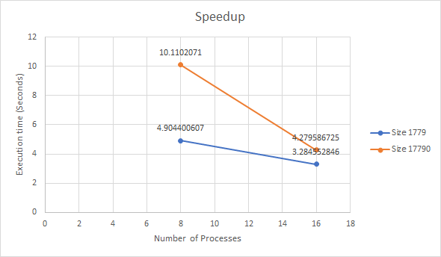
Speedup for Version 1
Speedup {seconds} for Parallel V1
 | Problem Size (N)
# Proc (comm_sz) | 1779 | 17790
8 | 4.904400607 | 10.1102071
16 | 3.284552846 | 4.279586725

Slide 24
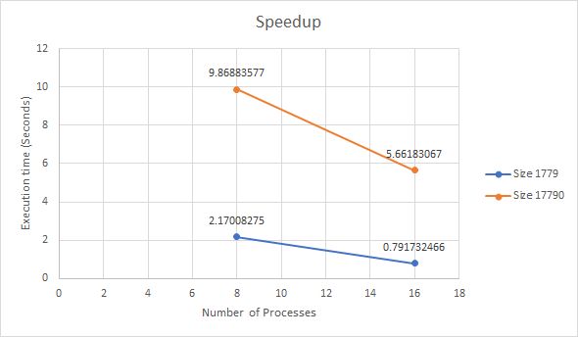
Speedup for Version 2
Speedup {seconds} for Parallel V2
 | Problem Size (N)
# Proc (comm_sz) | 1779 | 17790
8 | 2.17008275 | 9.86883577
16 | 0.791732466 | 5.66183067

Slide 25
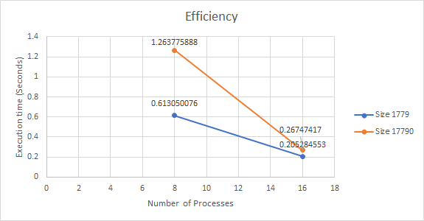
Efficiency for Version 1
Efficiency {seconds} for Parallel V1
 | Problem Size (N)
# Proc (comm_sz) | 1779 | 17790
8 | 0.613050076 | 1.263775888
16 | 0.205284553 | 0.26747417

Slide 26
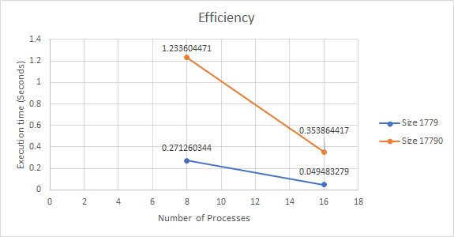
Efficiency for Version 2
Efficiency {seconds} for Parallel v2
 | Problem Size (N)
# Proc (comm_sz) | 1779 | 17790
8 | 0.271260344 | 1.233604471
16 | 0.049483279 | 0.353864417

Slide 27
Conclusions:
Parallel Version 1 was faster than Serial and Parallel Version 2
Using 8 processes was more efficient overall than 1 or 16 processes
Version 1 uses send and receive to share the text array
Version 2 uses reduce, but slower because each process is looking through the text file

Slide 28
Next Steps:
Create an emotional word comparative table and count the number of times each emotional word was used
Have a scale to determine if the article is considered emotionally biased.
Create a way to read in audio and video sources.
Determine other ways to rate possible bias rating of media

